Slide 1
Database Normalization:
Functional Dependency (FD) and
Multi-Valued Dependency (MVD)

Slide 2
Functional Dependencies
Functional Dependencies
We say an attribute, B, has a functional dependency on another attribute, A, if for any two records, which have
the same value for A, then the values for B in these two records must be the same. We illustrate this as:
  A → B
Example: Suppose we keep track of employee email addresses, and we only track one email address for each employee. Suppose each employee is identified by their unique employee number. We say there is a functional dependency of email address on employee number:
    employee number → email address

Slide 3
Functional Dependency
Notation: R.X => R.Y
Definition: Attribute Y of Relation R is functionally dependent on the Attribute X of Relation R when there is each value of R.Y associated with no more than one value of R.X. R.X and R.Y may be composite attributes.
Description:
  R .Y is functionally dependent on R.X
  R.X functionally determines R.Y

Slide 4
Full & Partial Dependency
R.A => R.B
If B is not functionally dependent on any subset of A (other than A itself), B is fully dependent on A in R.
If B is functionally dependent on a subset of A (other than A itself), B is partially dependent on A in R.

Slide 5
Functional Dependencies
EmpNum
EmpEmail
EmpFname
EmpLname
123
jdoe@abc.com
John
Doe
456
psmith@abc.com
Peter
Smith
555
alee1@abc.com
Alan
Lee
633
pdoe@abc.com
Peter
Doe
787
alee2@abc.com
Alan
Lee
If EmpNum is the PK then the FDs:
EmpNum → EmpEmail
EmpNum → EmpFname
EmpNum → EmpLname
must exist.

Slide 6
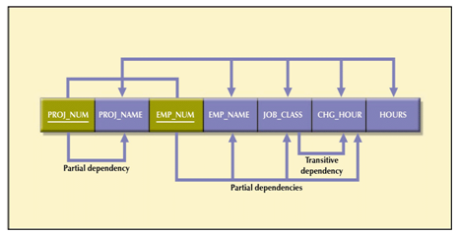
Functional Dependency
A relationship between attributes in which
one or more attributes determines the value
of another attribute(s) in the same table
  The Proj_Num “determines” the Proj_Name

Slide 7
Functional Dependencies
EmpNum → EmpEmail
EmpNum → EmpFname
EmpNum → EmpLname
3 different ways you might see FDs depicted
EmpEmail
EmpNum
EmpFname
EmpLname
EmpNum EmpEmail EmpFname EmpLname

Slide 8
Determinant
Functional Dependency
EmpNum → EmpEmail
Attribute on the LHS is known as the determinant
  EmpNum is a determinant of EmpEmail

Slide 9
Transitive dependency
Transitive dependency
Consider attributes A, B, and C, and where
A → B and B → C.
Functional dependencies are transitive, which means that we also have the functional dependency A → C
We say that C is transitively dependent on A through B.

Slide 10
Transitive dependency
EmpNum → DeptNum
EmpNum EmpEmail DeptNum DeptNname
DeptNum → DeptName
EmpNum EmpEmail DeptNum DeptNname
DeptName is transitively dependent on EmpNum via DeptNum
    EmpNum → DeptName

Slide 11
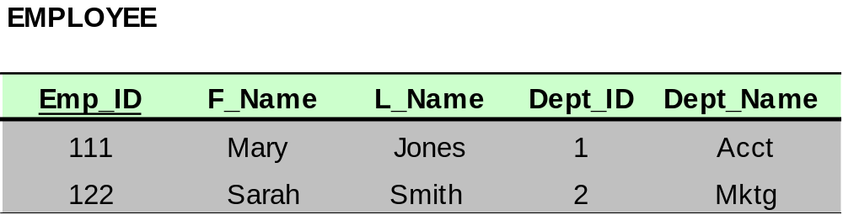
Dependencies: Definitions
Transitive Dependency – when a non-key attribute determines another non-key attribute.
Transitive Dependency

Slide 12
Partial dependency
A partial dependency exists when an attribute B is
functionally dependent on an attribute A, and A is a component of a multipart candidate key.
InvNum
LineNum
Qty
InvDate
Candidate keys: {InvNum, LineNum} InvDate is partially dependent on {InvNum, LineNum} as InvNum is a determinant of InvDate and InvNum is part of a candidate key

Slide 13
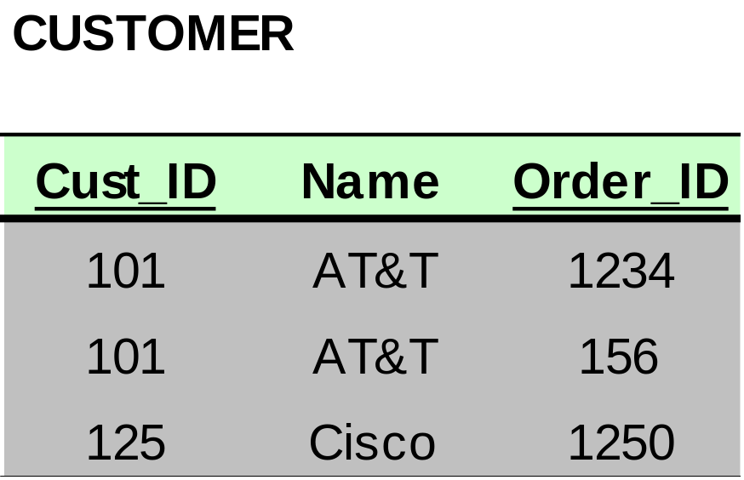
Dependencies: Definitions
Partial Dependency – when an non-key attribute is
determined by a part, but not the whole, of a COMPOSITE primary key.
Partial Dependency

Slide 14
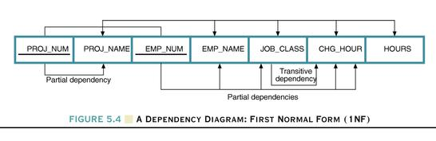
Dependency Diagram
Dependency Diagram
  The primary key components are bold, underlined, and shaded in a different color.
  The arrows above entities indicate all desirable dependencies, i.e., dependencies that are based on PK.
  The arrows below the dependency diagram indicate less desirable dependencies -- partial dependencies and transitive dependencies.

Slide 15
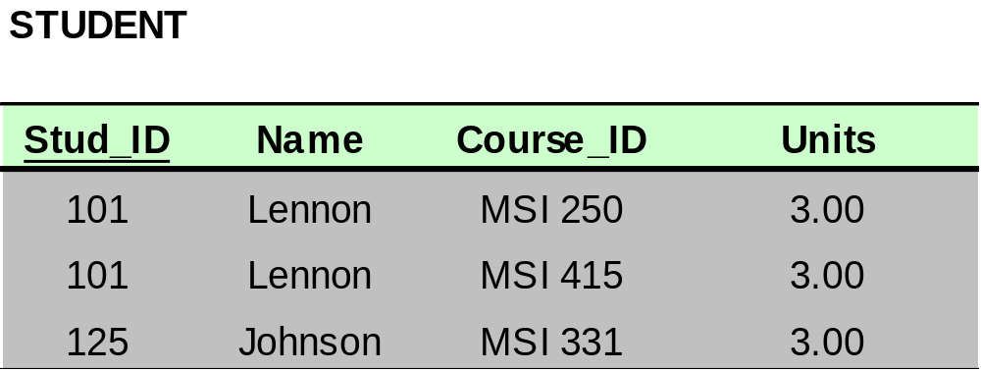
Dependencies: Definitions
Multivalued Attributes (or repeating groups): non-key attributes or groups of non-key attributes the values of
which are not uniquely identified by (directly or indirectly) (not functionally dependent on) the value of the Primary Key (or its part).

Slide 16
Multi-Valued Dependency (MVD)
Employee →→ Skill
Each employee has 1 or more skills
Student →→ Course
Each student can take 1 or more courses
Student →→ major
Each student can have 1 or more major

Slide 17
Logical Implication of Functional Dependencies
Reflexivity:
X Y → X, trivial dependency
Stname StId → Stname, trivial dependency
Augmentation:
If X → Y is true, then ZX → ZY is true
Transitivity:
If X→ Y and Y → Z hold, then X → Z hold

